Slide 1
Rotary Club of Dunedin Member Survey
Tuesday August 1st, 2017

Slide 2
34
Total Responses
Date Created: Tuesday, June 06, 2017
Complete Responses: 34

Slide 3
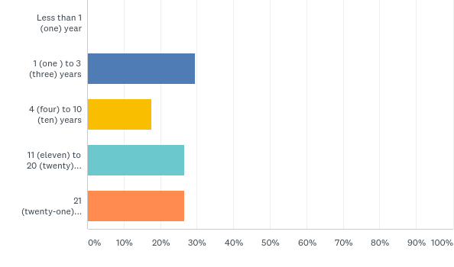
Q1: How long have you been a Member of the Rotary Club of Dunedin (RDC)?
Answered: 34 Skipped: 0

Slide 4
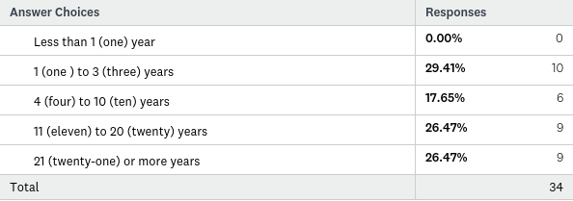
Q1: How long have you been a Member of the Rotary Club of Dunedin (RDC)?
Answered: 34 Skipped: 0

Slide 5
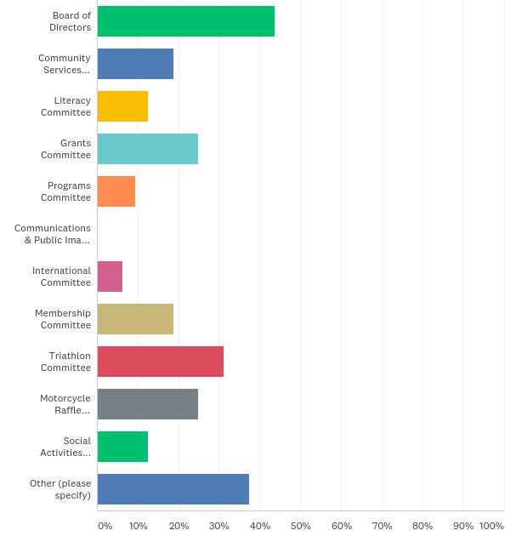
Q2: Currently, how involve are you with Rotary Club of Dunedin Committees and Governance? Check as many as apply.
Answered: 32 Skipped: 2

Slide 6
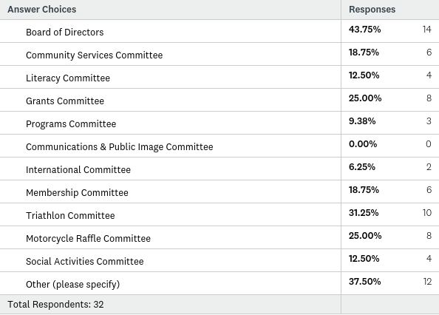
Q2: Currently, how involve are you with Rotary Club of Dunedin Committees and Governance? Check as many as apply.
Answered: 32 Skipped: 2

Slide 7
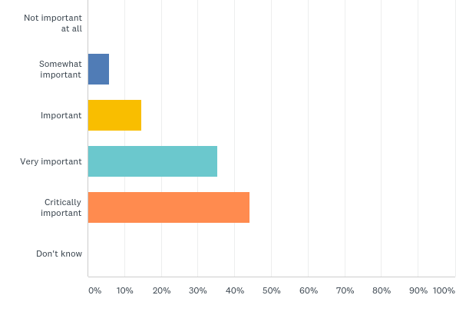
Q3: Over the course of the last few years the RCD has maintained a Membership of approximately 50 Members of which more than 12 are "Rule of 85". Please indicate how important it is for the Club to focus on Membership growth?
Answered: 34 Skipped: 0

Slide 8
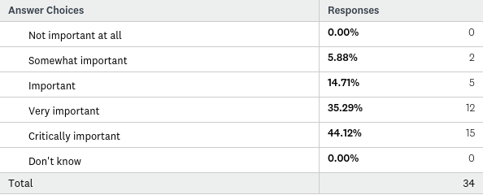
Q3: Over the course of the last few years the RCD has maintained a Membership of approximately 50 Members of which more than 12 are "Rule of 85". Please indicate how important it is for the Club to focus on Membership growth?
Answered: 34 Skipped: 0

Slide 9
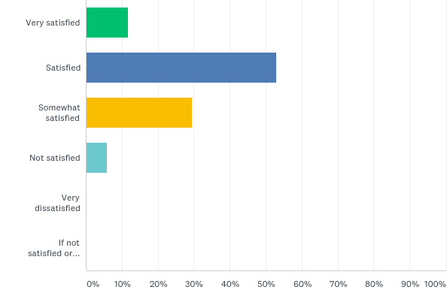
Q4: How satisfied are you as a Member of the Rotary Club of Dunedin?
Answered: 34 Skipped: 0

Slide 10
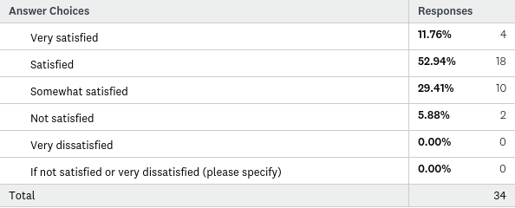
Q4: How satisfied are you as a Member of the Rotary Club of Dunedin?
Answered: 34 Skipped: 0

Slide 11
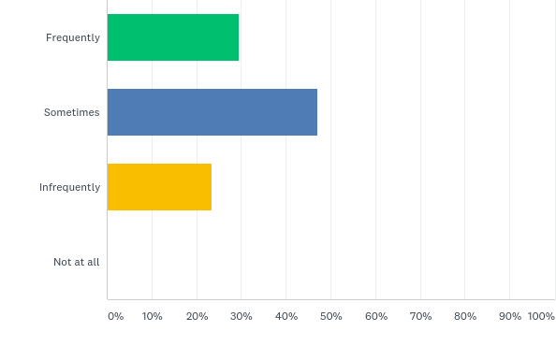
Q5: How frequently have you recommended RCD Membership to others?
Answered: 34 Skipped: 0

Slide 12
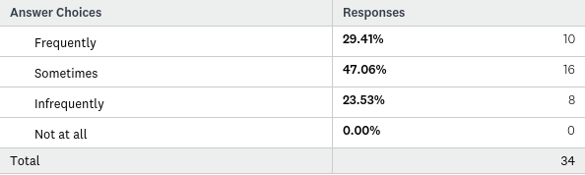
Q5: How frequently have you recommended RCD Membership to others?
Answered: 34 Skipped: 0

Slide 13
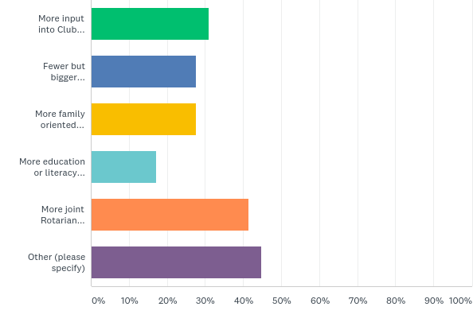
Q6: What would encourage you to become more active in RCD activities? Check any that interest you.
Answered: 29 Skipped: 5

Slide 14
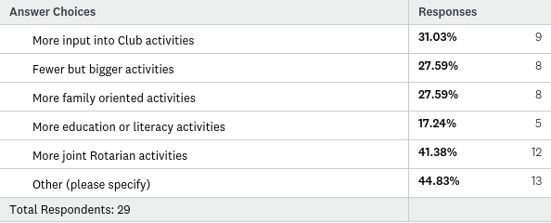
Q6: What would encourage you to become more active in RCD activities? Check any that interest you.
Answered: 29 Skipped: 5

Slide 15
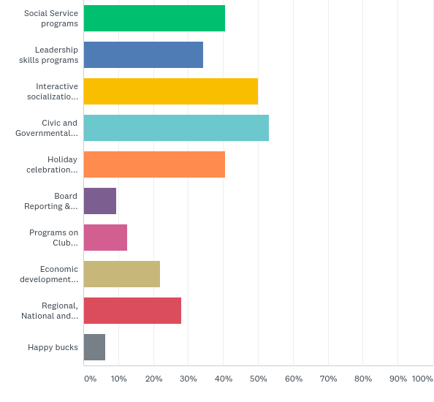
Q7: As a RCD Member what kinds of programs interest you most? (Select no more than 3.)
Answered: 32 Skipped: 2

Slide 16
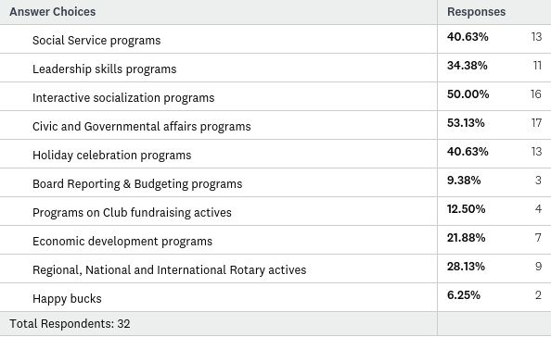
Q7: As a RCD Member what kinds of programs interest you most? (Select no more than 3.)
Answered: 32 Skipped: 2

Slide 17
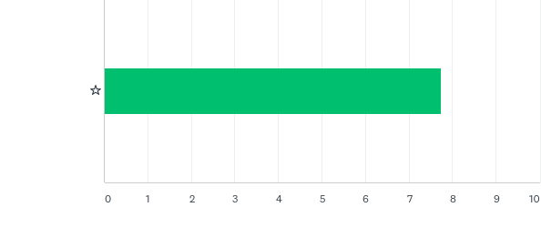
Q8: On a scale from 1-10 where 1 is worst and 10 is best or most how would you rate the importance of continuing the Harley Davidson Raffle?
Answered: 32 Skipped: 2

Slide 18

Q8: On a scale from 1-10 where 1 is worst and 10 is best or most how would you rate the importance of continuing the Harley Davidson Raffle?
Answered: 32 Skipped: 2

Slide 19
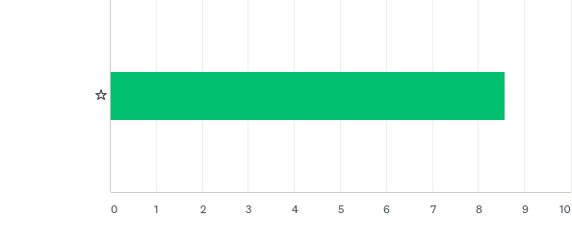
Q9: On a scale from 1-10 where 1 is worst and 10 is best or most how would you rate the importance of continuing the Triathlon?
Answered: 33 Skipped: 1

Slide 20

Q9: On a scale from 1-10 where 1 is worst and 10 is best or most how would you rate the importance of continuing the Triathlon?
Answered: 33 Skipped: 1

Slide 21

Q10: On a scale from 1-10 where 1 is worst and 10 is best or most how would you rate the importance of social and fellowship activities?
Answered: 34 Skipped: 0

Slide 22

Q10: On a scale from 1-10 where 1 is worst and 10 is best or most how would you rate the importance of social and fellowship activities?
Answered: 34 Skipped: 0

Slide 23
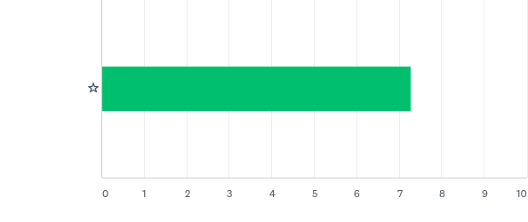
Q11: On a scale from 1-10 where 1 is worst and 10 is best or most how would you rate the importance of cooperation and interaction with the other Dunedin Rotary Clubs? Skip this question if you don't know enough to rate the issue.
Answered: 32 Skipped: 2

Slide 24

Q11: On a scale from 1-10 where 1 is worst and 10 is best or most how would you rate the importance of cooperation and interaction with the other Dunedin Rotary Clubs? Skip this question if you don't know enough to rate the issue.
Answered: 32 Skipped: 2

Slide 25
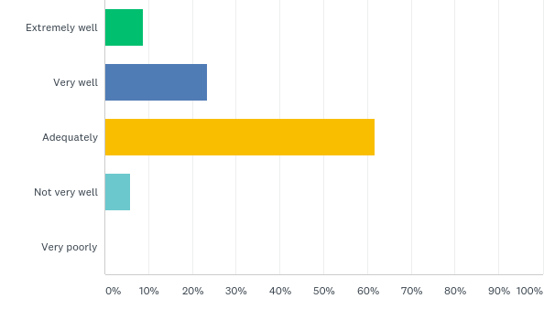
Q12: How well do you feel the RCD communicates events and activities to its Members?
Answered: 34 Skipped: 0

Slide 26
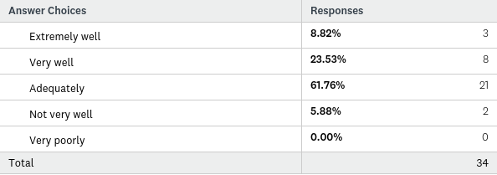
Q12: How well do you feel the RCD communicates events and activities to its Members?
Answered: 34 Skipped: 0

Slide 27
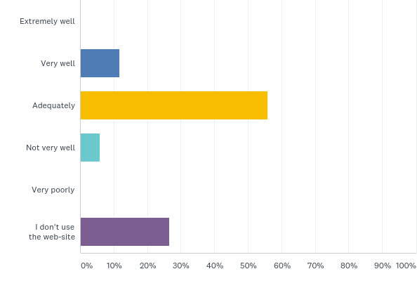
Q13: How well does the RCD web-site serve your needs?
Answered: 34 Skipped: 0

Slide 28
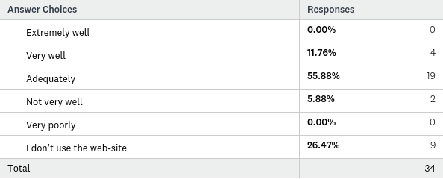
Q13: How well does the RCD web-site serve your needs?
Answered: 34 Skipped: 0

Slide 29
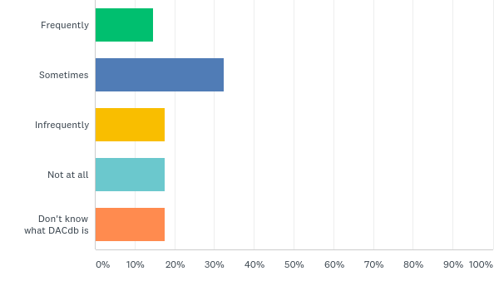
Q14: How often do you refer to DACdb for RCD information?
Answered: 34 Skipped: 0

Slide 30
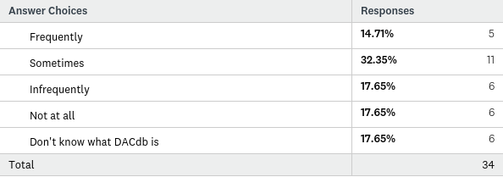
Q14: How often do you refer to DACdb for RCD information?
Answered: 34 Skipped: 0

Slide 31
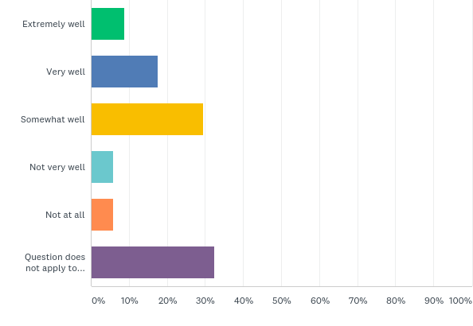
Q15: How well does the Rotary Club of Dunedin serve your professional interests and needs?
Answered: 34 Skipped: 0

Slide 32
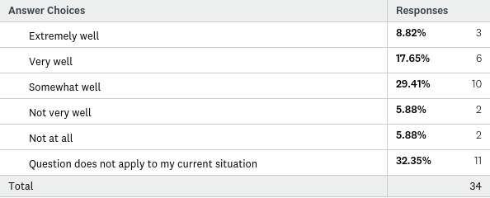
Q15: How well does the Rotary Club of Dunedin serve your professional interests and needs?
Answered: 34 Skipped: 0

Slide 33
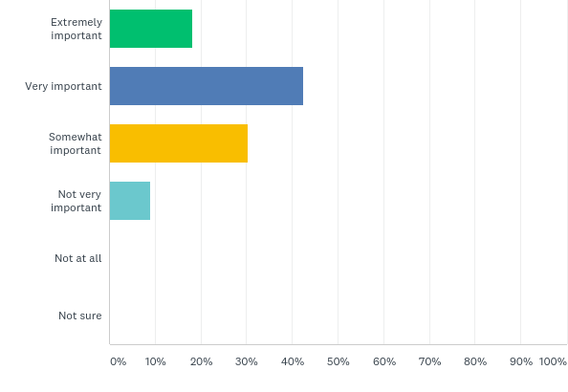
Q16: How would you rate the importance of the Dunedin Rotary Club to your community/social connectivity?
Answered: 33 Skipped: 1

Slide 34
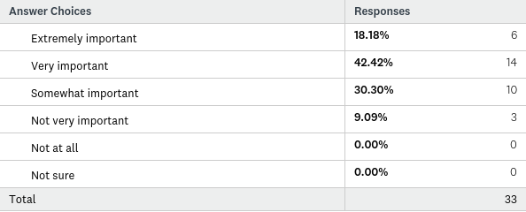
Q16: How would you rate the importance of the Dunedin Rotary Club to your community/social connectivity?
Answered: 33 Skipped: 1

Slide 35
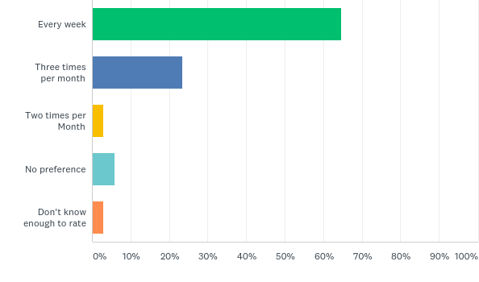
Q17: How often should the Rotary Club of Dunedin meet?
Answered: 34 Skipped: 0

Slide 36
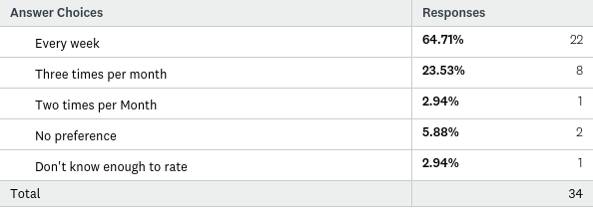
Q17: How often should the Rotary Club of Dunedin meet?
Answered: 34 Skipped: 0

Slide 37
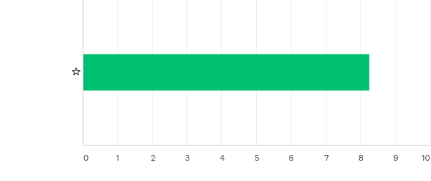
Q18: On a scale of 1-10 with 10 being best how would rate the overall importance of the RCD to your community and service involvement?
Answered: 34 Skipped: 0

Slide 38

Q18: On a scale of 1-10 with 10 being best how would rate the overall importance of the RCD to your community and service involvement?
Answered: 34 Skipped: 0

Slide 39
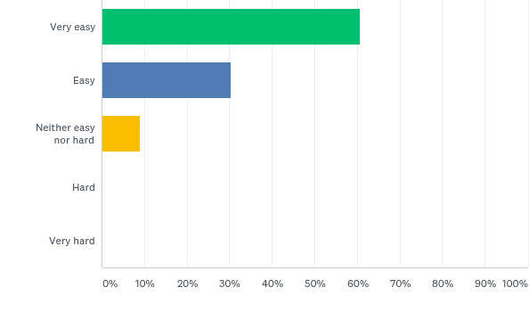
Q20: How easy or hard was this survey for you?
Answered: 33 Skipped: 1

Slide 40
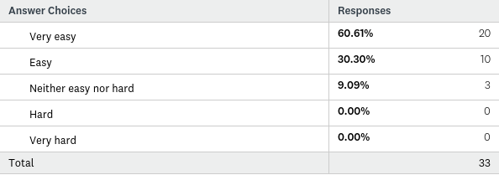
Q20: How easy or hard was this survey for you?
Answered: 33 Skipped: 1

